Slide 1
E-R Modeling and E-R Diagram
E-R Modeling is used under Conceptual Design of your Database.

Slide 2
During Conceptual Design of database we decide
What are the entities and relationships in the enterprise?
What information about these entities and relationships should we store in the database?
What are the integrity constraints or business rules that hold?

Slide 3
A database `schema’ in the ER Model can be represented pictorially (ER diagrams).
Can map an ER diagram into a relational schema.
The ER diagram is just an approximate description of the data, constructed through a subjective evaluation of the information collected during requirements analysis.

Slide 4
ER Model Basics
name
ssn
lot
Employees
Entity: Real-world object distinguishable from other objects. An entity is described using a set of attributes. Each attribute has a domain.
Entity Set: A collection of similar entities. E.g., all employees.
All entities in an entity set have the same set of attributes. (Until we consider ISA hierarchies, anyway!)
Each entity set has a key.
Notes:
3

Slide 5
Two classes of entities are there:
Regular Entity or Strong Entity
Weak Entity
Attribute
Properties/characteristics which describe entities are called attributes.
Key Attribute
Multivalued Attributes

Slide 6
Derived Attribute: which can be derived from a given value
Relationships
Associations between entities are called relationships

Slide 7
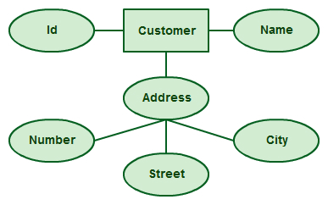

Examples of attributes
Regular attributes of an entity
Multivalued attributes

Slide 8
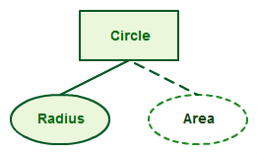
Derived attribute

Slide 9

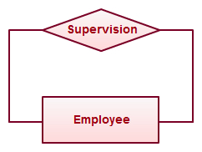
Examples of Relationship
Regular relationship
Recursive Relationship

Slide 10
ER Model Basics (Contd.)
name
ssn
lot
since
Employees
name
dname
super-visor
subor-dinate
ssn
lot
did
budget
Works_In
Reports_To
Employees
Departments
Relationship: Association among two or more entities. E.g., Employee Atish works in Pharmacy department.
Relationship Set: Collection of similar relationships.
An n-ary relationship set R relates n entity sets E1 ... En; each relationship in R involves entities e1 E1, ..., en En
Same entity set could participate in different relationship sets, or in different “roles” in same set.
Notes:
4

Slide 11
Cardinality of a Relationship
Relationship cardinalities specify how many of each entity type is allowed. Relationships can have four possible connectivity's as given below.
1. One to one (1:1) relationship
2. One to many (1:N) relationship
3. Many to one (M:1) relationship
4. Many to many (M:N) relationship

Slide 12
Examples

Slide 13
Degree of a Relationship
Degree of a relationship is the number of entity types involved. The n-ary relationship is the general form for degree n.
Special cases are unary, binary, and ternary where the degree is 1, 2, and 3, respectively.
Example for unary relationship : An employee is a manager of another employee
Example for binary relationship : An employee works-for department.
Example for ternary relationship : customer purchase item from a shop keeper

Slide 14
Participation Constraints
Does every department have a manager?
If so, this is a participation constraint: the participation of Departments in Manages is said to be total (vs. partial).
Every Department entity must appear in an instance of the relationship Works_In (have an employee) and every Employee must be in a Department
Both Employees and Departments participate totally in Works_In
name
name
dname
since
dname
ssn
did
did
budget
lot
budget
Employees
Manages
Departments
Works_In
since
Notes:
8

Slide 15
Weak Entities
A weak entity can be identified uniquely only by considering the primary key of another (owner) entity.
Owner entity set and weak entity set must participate in a one-to-many relationship set (one owner, many weak entities).
Weak entity set must have total participation in this identifying relationship set.
name
ssn
lot
cost
pname
age
Employees
Policy
Dependents
Notes:
10

Slide 16
ISA (`is a’) Hierarchies
name
ssn
lot
Employees
hourly_wages
hours_worked
ISA
contractid
Hourly_Emps
Contract_Emps
As in C++, attributes can be inherited.
If we declare A ISA B, every A entity is also considered to be a B entity.
Upwards is generalization. Down is specialization
Notes:
12

Slide 17
Constraints in ISA relation
Overlap constraints: Can Joe be an Hourly_Emps as well as a Contract_Emps entity? (Allowed/disallowed)
Covering constraints: Does every Employees entity also have to be an Hourly_Emps or a Contract_Emps entity? (Yes/no)
Reasons for using ISA:
To add descriptive attributes specific to a subclass.
To identify entitities that participate in a relationship.

Slide 18
Aggregation
name
ssn
lot
Employees
Used when we have to model a relationship involving (entitity sets and) a relationship set.
Monitors
until
started_on
since
dname
pid
pbudget
did
budget
Projects
Sponsors
Departments
Aggregation allows us to treat a relationship set as an entity set for purposes of participation in (other) relationships.
Notes:
2

Slide 19
Aggregation vs. ternary relationship:
Monitors in last example is a distinct relationship, with a descriptive attribute.
Also, can say that each sponsorship is monitored by at most one employee.

Slide 20
Conceptual Design Using the ER Model
Design choices:
Should a concept be modeled as an entity or a relationship?
Identifying relationships: Binary or ternary? Aggregation?
Constraints in the ER Model:
A lot of data semantics can (and should) be captured.
But some constraints cannot be captured in ER diagrams.
Notes:
3

Slide 21
Entity vs. Attribute
Should address be an attribute of Employees or an entity (connected to Employees by a relationship)?
Depends upon the use we want to make of address information, and the semantics of the data:
If we have several addresses per employee, address must be an entity (since attributes cannot be set-valued).
If the structure (city, street, etc.) is important, e.g., we want to retrieve employees in a given city, address must be modeled as an entity (since attribute values are atomic).

Slide 22
Entity vs. Attribute (Contd.)
from
to
name
dname
Works_In4 does not allow an employee to work in a department for two or more periods.
Similar to the problem of wanting to record several addresses for an employee: We want to record several values of the descriptive attributes for each instance of this relationship. Accomplished by introducing new entity set, Duration.
ssn
lot
did
budget
Employees
Works_In4
Departments
name
dname
ssn
lot
did
budget
Employees
Works_In4
Departments
from
Duration
to
Notes:
5

Slide 23
Entity vs. Relationship
since
dbudget
name
dname
ssn
lot
did
budget
Employees
Manages2
Departments
ER diagram OK if a manager gets a separate discretionary budget for each dept.
What if a manager gets a discretionary budget that covers all managed depts?
Redundancy: dbudget stored for each dept managed by manager.
Misleading: Suggests dbudget associated with department-mgr combination.
Notes:
6

Slide 24
This fixes the problem!
name
ssn
lot
since
dname
Employees
did
budget
Manages2
Departments
ISA
Managers
dbudget

Slide 25
Binary vs. Ternary Relationships
name
ssn
lot
pname
age
Employees
Covers
Dependents
Bad design
Policies
policyid
cost
If each policy is owned by just 1 employee, and each dependent is tied to the covering policy, first diagram is inaccurate.
What are the additional constraints do we need?
Notes:
7

Slide 26
Better design
name
pname
age
ssn
lot
Dependents
Employees
Purchaser
Beneficiary
Policies
policyid
cost
Define the Key constraint
Total participation of policies in purchaser relationship
The ternary relationships are break down into binary relationships again.

Slide 27
Summary of ER (Contd.)
Several kinds of integrity constraints can be expressed in the ER model: key constraints, participation constraints, and overlap/covering constraints for ISA hierarchies. Some foreign key constraints are also implicit in the definition of a relationship set.
Some constraints (notably, functional dependencies) cannot be expressed in the ER model.
Constraints play an important role in determining the best database design for an enterprise.
Notes:
12

Slide 28
Summary of ER (Contd.)
ER design is subjective. There are often many ways to model a given scenario! Analyzing alternatives can be tricky, especially for a large enterprise. Common choices include:
Entity vs. attribute, entity vs. relationship, binary or n-ary relationship, whether or not to use ISA hierarchies, and whether or not to use aggregation.
Ensuring good database design: resulting relational schema should be analyzed and refined further. FD information and normalization techniques are especially useful.
Notes:
13

Slide 29
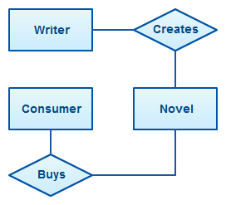
Some more examples of ER Diagrams
An Entity Relationship Diagram (ERD) is a visual representation of different entities within a system and how they relate to each other. For example, the elements writer, novel, and a consumer may be described using ER diagrams the following way:

Slide 30
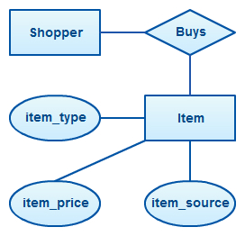
For example, an inventory software used in a retail shop will have a database that monitors elements such as purchases, item, item type, item source and item price. Rendering this information through an ER diagram would be something like this:

Slide 31
How to Draw ER Diagrams
Identify all the entities in the system. An entity should appear only once in a particular diagram. Create rectangles for all entities and name them properly.
Identify relationships between entities. Connect them using a line and add a diamond in the middle describing the relationship.
Add attributes for entities. Give meaningful attribute names so they can be understood easily.

Slide 32
ER Diagram best practices
Provide a precise and appropriate name for each entity, attribute, and relationship in the diagram. Terms that are simple and familiar always beats vague, technical-sounding words.
In naming entities, remember to use singular nouns. However, adjectives may be used to distinguish entities belonging to the same class (part-time employee and full-time employee, for example). Meanwhile attribute names must be meaningful, unique, system-independent, and easily understandable.
Remove vague, redundant or unnecessary relationships between entities.
Never connect a relationship to another relationship.
Make effective use of colors. You can use colors to classify similar entities or to highlight key areas in your diagrams.

Slide 33
ERD Case Study :
In a University , there are several departments and each department has a head of department who belongs to Faculty. Department have a name , phone extension , specific mailing address and Students that belong to the department. Students can belong to only one Department at a time and Department can have more than one or no Student
Students and faculty have names and unique identification numbers , with address , age , gender and other information. Student studies different Courses offered by University .
Faculty teaches these Courses . In each semester one student can take more than one course and Faculty can teach more than one courses . Faculty members can teach in multiple Departments. Each course can be taught by many faculty members or no one

Slide 34
ERD Case Study :
Faculty members are also working on multiple research projects. These projects are funded by government and university.
One project can have more than one faculty member and one faculty member can work on more than one project
Huff , Looks like a long task.
Lets apply our four steps on this requirement. Think of them and study this requirement again.

Slide 35
In a University , there are several departments and each department has a head of department who belongs to Faculty. Department have a name , phone extension , specific mailing address and Students that belong to the department. Students can belong to only one Department at a time and Department can have more than one or no Student.
Students and faculty have names and unique identification numbers , with address , age , gender and other information. Student studies different
Courses offered by University .
Faculty teaches these Courses . In each semester one student can take more than one course and Faculty can teach more than one courses . Faculty members can teach in multiple Departments. Each course can be taught by many faculty members or no one

Slide 36
Faculty members are also working on multiple research projects. These projects are funded by government and university. One project can have more than one faculty member and one faculty member can work on more than one project
Decide the relationships, cardinality and degree of relationships. (Different software packages denote various notations of ER diagrams)
Draw entities and attributes.

Slide 37
A primary key is a must attribute for every entity .
Student have Name , age , gender , address , phone Number , Roll Number , Semester , Course_ID and Student_ID.
Faculty have Name , age , gender , address , phone Number , Semester , Course_ID, Grade , Salary , Faculty_ID and designation.
Course have Name , Code , Student_ID , Faculty_ID , Department_ID and Course_ID.
Department have Name , Student_ID , Faculty_ID and Department_ID.
Research Project – Project_ID, Faculty_ID , Name , Duration.

Slide 38
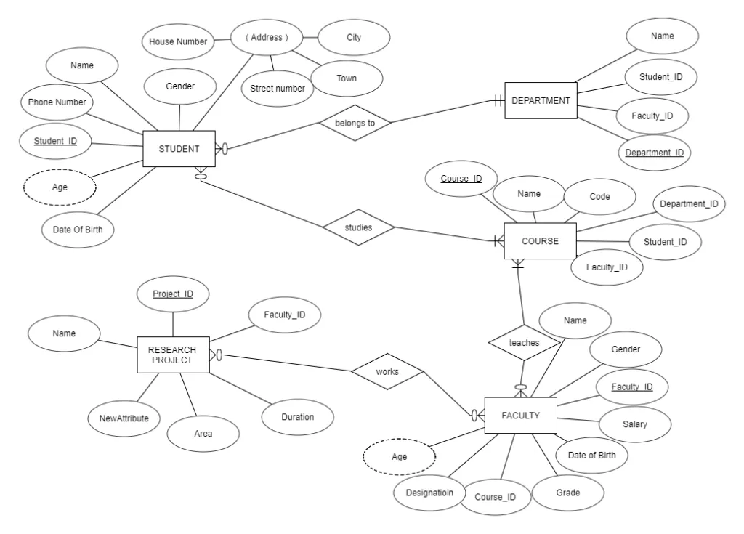
Final ER diagram may look like this:

Slide 39
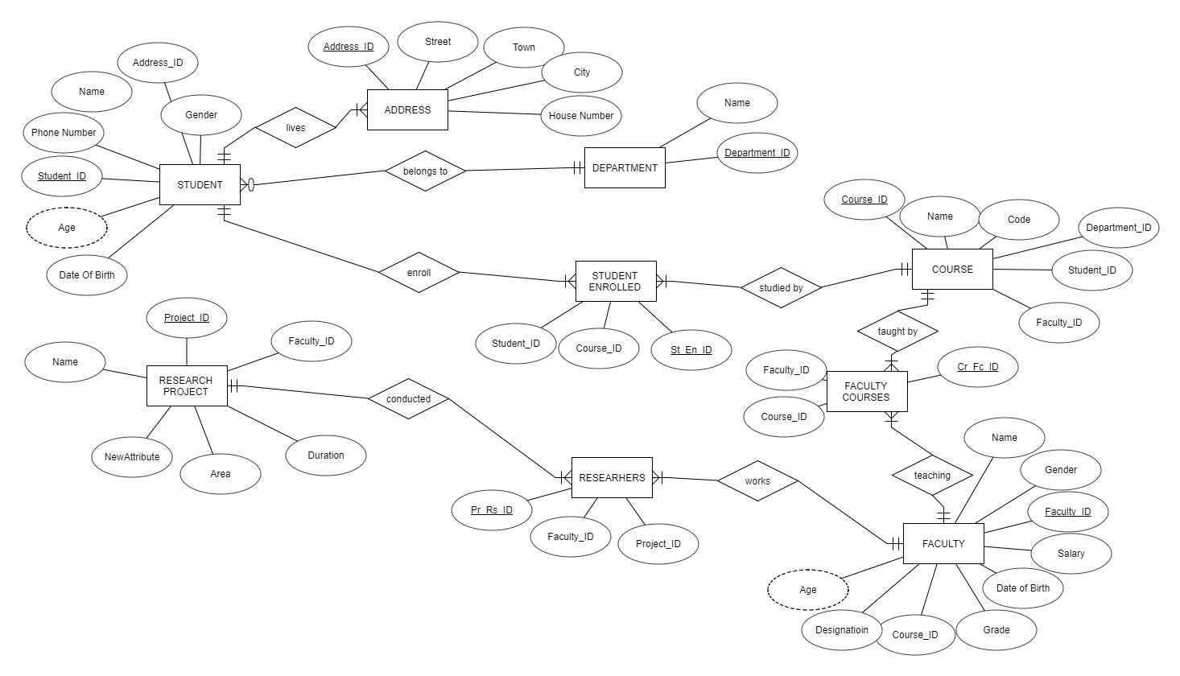
If we add student enrolled and Researchers , faculty courses information the final ER diagram may be

